Slide 1

Université de Mostaganem — Dr. Madani BELACEL
ICT Tutorial 04 — Microsoft Word: Academic Office Automation
Module TIC — Dr. BELACEL Madani
Université de Mostaganem — MCB

Slide 2
Université de Mostaganem — Dr. Madani BELACEL
🎯 Objectifs pédagogiques
• Comprendre les concepts clés
• Appliquer les compétences
• Évaluer les technologies

Slide 3
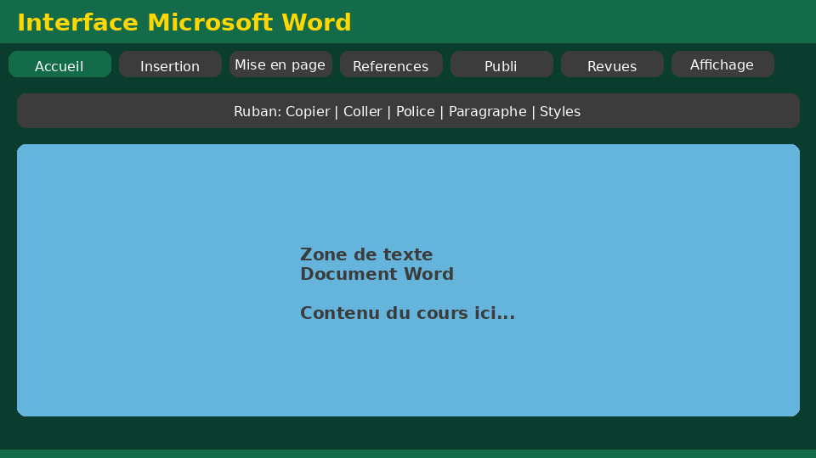
Université de Mostaganem — Dr. Madani BELACEL
📋 Plan du cours
• Exercise 1 — Layout(18 min)
• Exercise 2 — Styles(18 min)
• Exercise 3 — Table of contents(15 min)
• Exercise 4 — Tables and lists(15 min)
• Exercise 5 — Export(14 min)

Slide 4
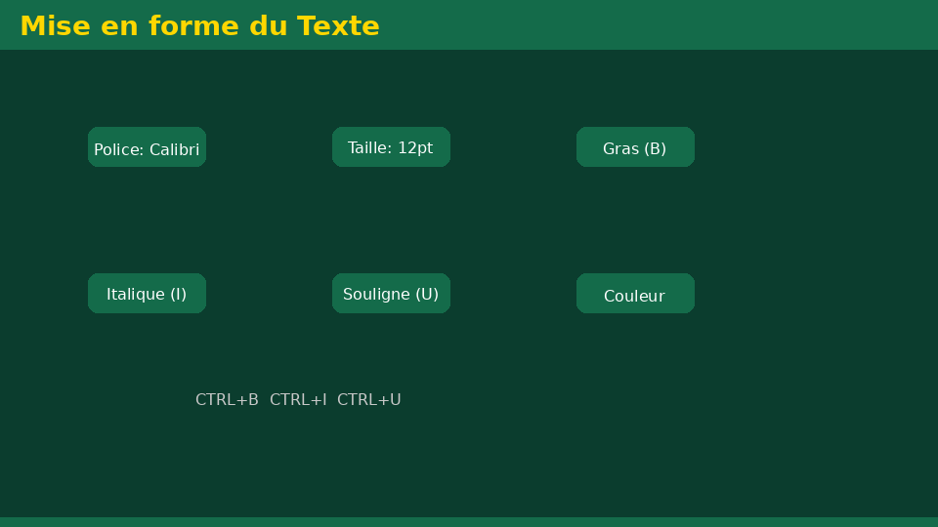
Exercise 1 — Layout(18 min)
• Statement:Apply all academic standards (font, line spacing, margins, pagination).
• Corrected:Times New Roman 12, line spacing 1.5, margins 2.5 cm, bottom right pagination.
Université de Mostaganem — Dr. Madani BELACEL

Slide 5
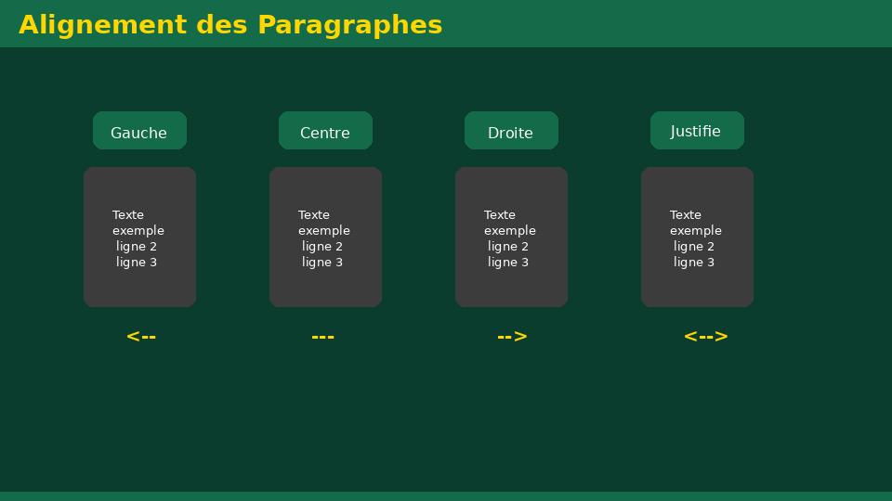
Exercise 2 — Styles(18 min)
• Statement:Write a 2-page mini-report with Heading 1, Heading 2 and Normal.
• Fixed:Consistent hierarchy, no manual formatting on titles.
Université de Mostaganem — Dr. Madani BELACEL

Slide 6
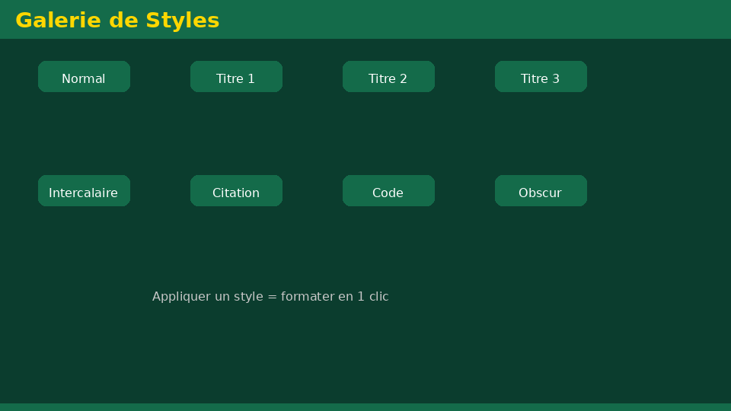
Exercise 3 — Table of contents(15 min)
• Statement:Insert and update an automatic table of contents.
• Fixed:References → Table of Contents → Update numbers.
Université de Mostaganem — Dr. Madani BELACEL

Slide 7
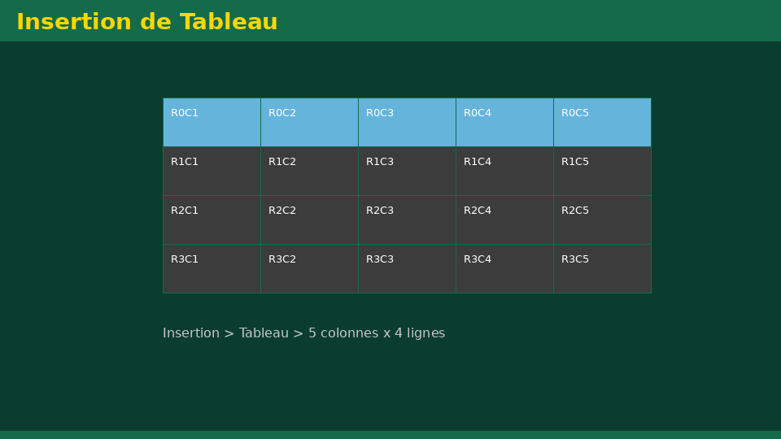
Exercise 4 — Tables and lists(15 min)
• Statement:Create a comparative table and a numbered list.
• Corrected:Table with headers, numbered list for methodological steps.
Université de Mostaganem — Dr. Madani BELACEL

Slide 8
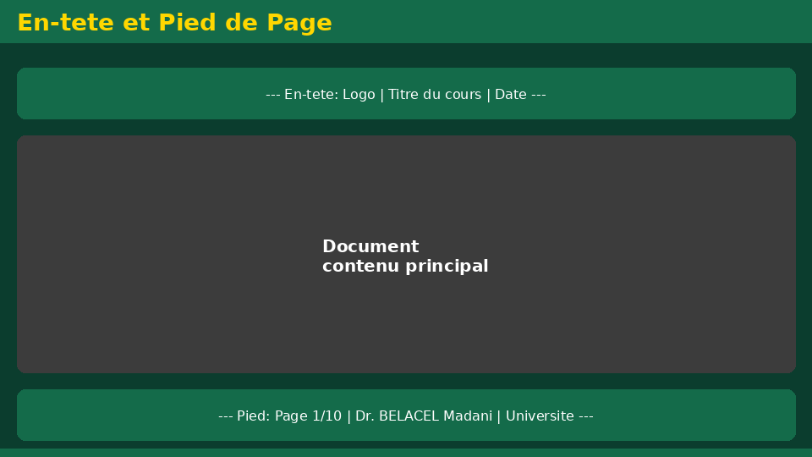
Exercise 5 — Export(14 min)
• Statement:Save as .docx and export as PDF with academic naming.
• Corrected:2026-06-04_TIC_TD4_BELACEL_v1.docx+ associated PDF.
Université de Mostaganem — Dr. Madani BELACEL

Slide 9
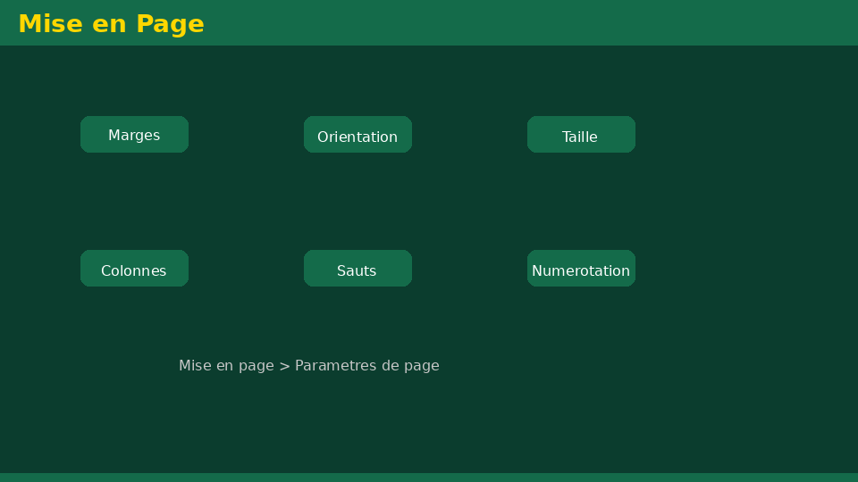
• Statement:Apply all academic standards (font, line spacing, margins, pagination).
• Statement:Write a 2-page mini-report with Heading 1, Heading 2 and Normal.
• Statement:Insert and update an automatic table of contents.
📝 Points clés à retenir
Université de Mostaganem — Dr. Madani BELACEL

Slide 10
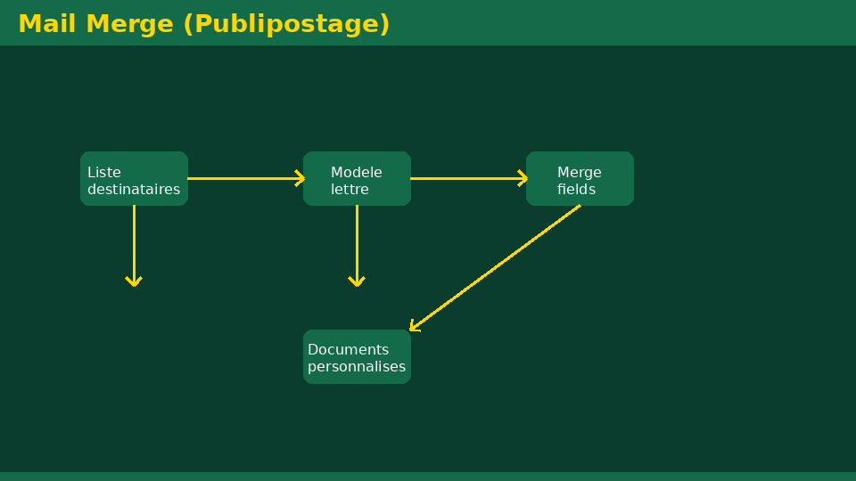
• Statement:Apply all academic standards (font, line spacing, margins, pagination).
• Statement:Write a 2-page mini-report with Heading 1, Heading 2 and Normal.
• Statement:Insert and update an automatic table of contents.
📝 Points clés à retenir
Université de Mostaganem — Dr. Madani BELACEL

Slide 11
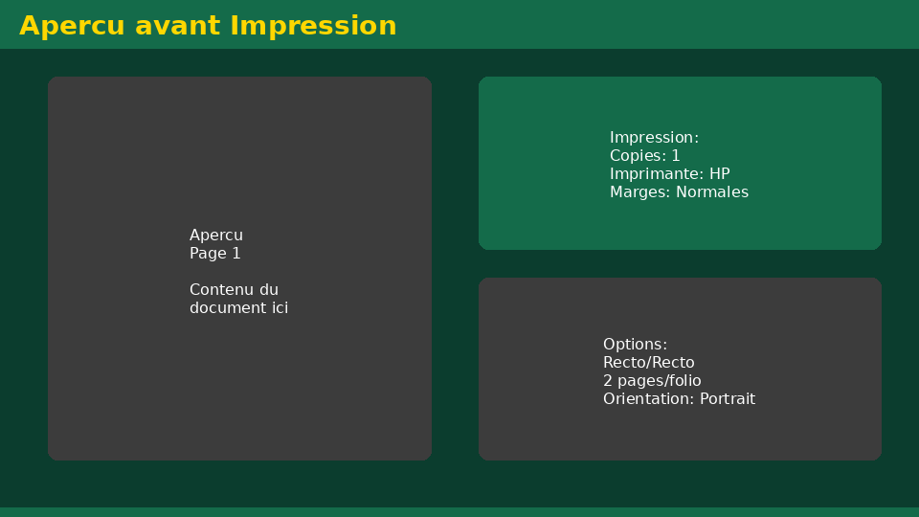
• Statement:Apply all academic standards (font, line spacing, margins, pagination).
• Statement:Write a 2-page mini-report with Heading 1, Heading 2 and Normal.
• Statement:Insert and update an automatic table of contents.
📝 Points clés à retenir
Université de Mostaganem — Dr. Madani BELACEL

Slide 12
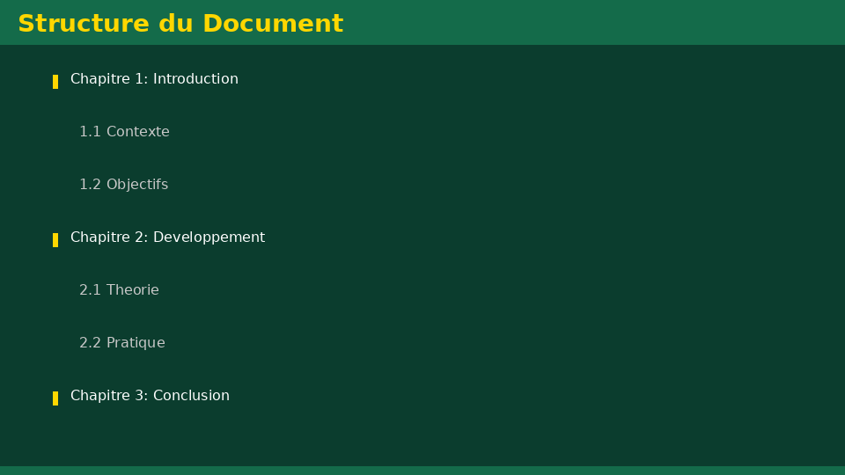
• Statement:Apply all academic standards (font, line spacing, margins, pagination).
• Statement:Write a 2-page mini-report with Heading 1, Heading 2 and Normal.
• Statement:Insert and update an automatic table of contents.
📝 Points clés à retenir
Université de Mostaganem — Dr. Madani BELACEL

Slide 13

Université de Mostaganem — Dr. Madani BELACEL
📝 Points clés à retenir
• Statement:Apply all academic standards (font, line spacing, margins, pagination).
• Statement:Write a 2-page mini-report with Heading 1, Heading 2 and Normal.
• Statement:Insert and update an automatic table of contents.
• Statement:Create a comparative table and a numbered list.
• Statement:Save as .docx and export as PDF with academic naming.

Slide 14
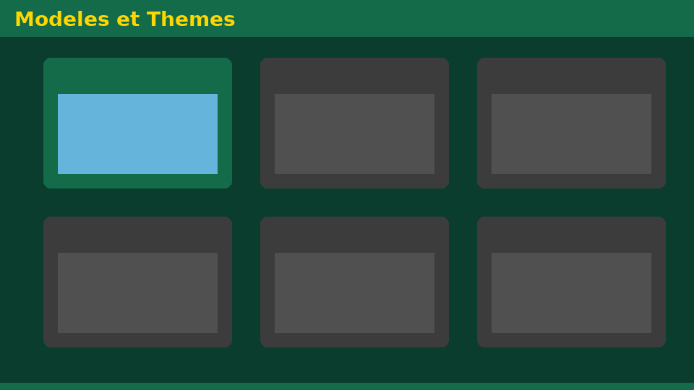
Université de Mostaganem — Dr. Madani BELACEL
✏️ Exercices d'application
• Définir les concepts principaux du cours
• Identifier les applications pratiques
• Résoudre les exercices du TD
• Synthétiser les points clés en un paragraphe
• Préparer une courte présentation orale

Slide 15
Université de Mostaganem — Dr. Madani BELACEL
🎓 Conclusion
Dr. BELACEL Madani Maître de Conférences B Université de Mostaganem madani.belacel@univ-mosta.dz

